Slide 1
Ensembles Part 1 – Bagging & Random Forests
Geoff Hulten

Slide 2
Ensemble Overview
Bias / Variance challenges
Simple models can’t represent complex concepts (bias)
Complex models can overfit noise and small deltas in data (variance)
Instead of learning one model, learn several (many) and combine them
Can mitigate some bias / variance problems
Often results in better accuracy, sometimes significantly better

Slide 3
Example of Ensembles
Accuracy 97.1%
Average 10 Trees
Model doesn’t match concept well
Decision Trees
on different samples
Accuracy 96%
Accuracy 95.2%
Accuracy 92.9%
Accuracy 93.5%
Accuracy 97.2%
Target Concept
Decision Tree
Average 50 Trees
$$x_{2}$$
$$x_{1}$$
Accuracy 94.7%
Accuracy 93.4%
Average 500 Trees
Accuracy 94.0%
Accuracy 93.2%
Accuracy 95.3%
Accuracy 97.9%
200 samples per tree, minToSplit = 5

Slide 4
Approaches to Ensembles
Learn the concept many different ways and combine
Prefers higher variance, relatively low bias base models
Models are independent
Robust vs overfitting
Techniques: Bagging, Random Forests, Stacking
Learn different parts of the concept with different models and combine
Can work with high bias base models (weak learners) and high variance
Each model depends on previous models
May overfit
Techniques: Boosting, Gradient Boosting Machines (GBM)

Slide 5
Bagging
Parallel Training
Possible
Base Models
Uniform voting
to classify new samples
Bootstrap Sample
Training Set
Sample 1
Ensemble Prediction
Training Set
Sample 2
Training
Set
…
…
Generate K training sets by sampling from the original training set
“Bootstrap” sample
Training set contains N training examples
Each of the K training samples also contains N training examples
Created by sampling with replacement from the original
Learn one model on each of the K training sets
Combine their predictions by uniform voting
Training Set
Sample K
Sample
Train
Vote

Slide 6
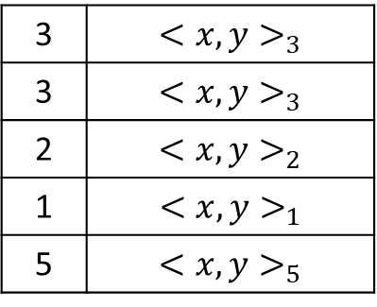
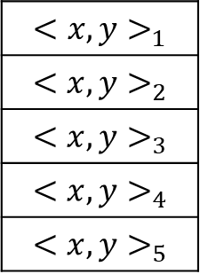
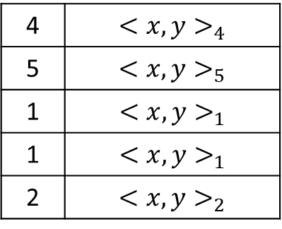
Bootstrap sampling – sampling with replacement
n random numbers 1..n
Examples from selected indices
3 | $${<x,y>}_{3}$$
3 | $${<x,y>}_{3}$$
2 | $${<x,y>}_{2}$$
1 | $${<x,y>}_{1}$$
5 | $${<x,y>}_{5}$$
Most bootstrap samples contain duplicates from the original
Most samples are missing some from the original -- ~37%
Widely used technique
$${<x,y>}_{1}$$
$${<x,y>}_{2}$$
$${<x,y>}_{3}$$
$${<x,y>}_{4}$$
$${<x,y>}_{5}$$
Original Training Set
4 | $${<x,y>}_{4}$$
5 | $${<x,y>}_{5}$$
1 | $${<x,y>}_{1}$$
1 | $${<x,y>}_{1}$$
2 | $${<x,y>}_{2}$$

Slide 7
Bagging Summary
Each model learns the concept a different way
Bootstrap sampling Accentuates variance between individual models
Voting tends to cancel out the variance without increasing bias

Slide 8
Random Forests
Build N trees
Bootstrap sample for each training set (Bagging)
Restrict the features each tree can use (Inject Variance at cost of some Bias)
Combine by uniform voting

Slide 9
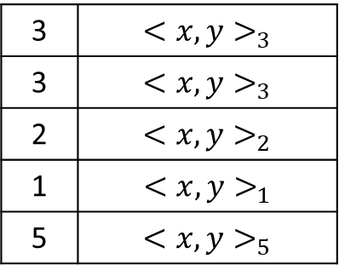
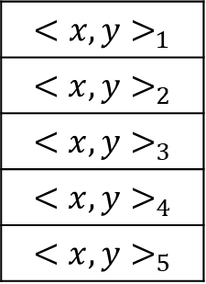
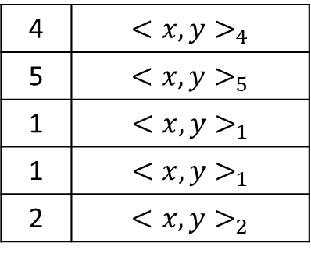
Example RandomForest Grow
Selected features: $x_{1} x_{2}$
$$x_{1}=1?$$
3 | $${<x,y>}_{3}$$
3 | $${<x,y>}_{3}$$
2 | $${<x,y>}_{2}$$
1 | $${<x,y>}_{1}$$
5 | $${<x,y>}_{5}$$
False
True
Grow Tree 1
$$y=1$$
$$x_{2}=1?$$
Features: $x_{1} x_{2}$ $x_{3}$
Tree 1
False
True
$${<x,y>}_{1}$$
$${<x,y>}_{2}$$
$${<x,y>}_{3}$$
$${<x,y>}_{4}$$
$${<x,y>}_{5}$$
$$y=1$$
$$y=0$$
Tree 2
Selected features: $x_{1} x_{3}$
$$x_{3}=1?$$
4 | $${<x,y>}_{4}$$
5 | $${<x,y>}_{5}$$
1 | $${<x,y>}_{1}$$
1 | $${<x,y>}_{1}$$
2 | $${<x,y>}_{2}$$
False
True
Grow Tree 2
$$x_{1}=1?$$
$$y=0$$
False
True
$$y=1$$
$$y=0$$

Slide 10
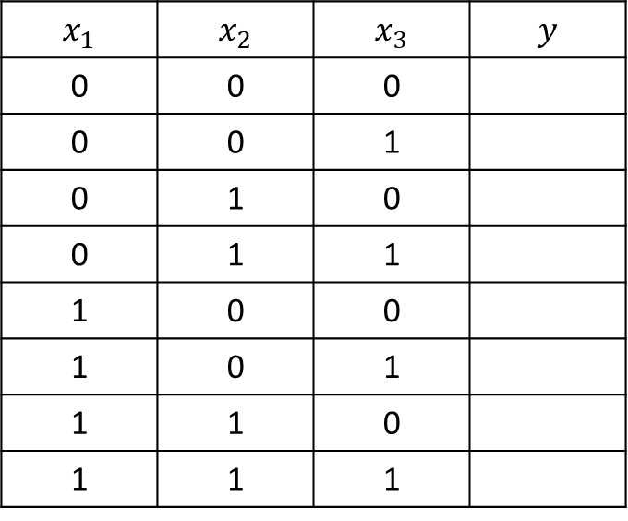
Example RandomForest Predict
$$x_{1}=1?$$
False
True
$$x_{2}=1?$$
False
True
$$x_{1}$$ | $$x_{2}$$ | $$x_{3}$$ | $$y$$
0 | 0 | 0
0 | 0 | 1
0 | 1 | 0
0 | 1 | 1
1 | 0 | 0
1 | 0 | 1
1 | 1 | 0
1 | 1 | 1
$$y=1$$
$$x_{2}=1?$$
False
True
$$y=0$$
$$y=1$$
$$y=1$$
$$y=0$$
$$x_{3}=1?$$
False
True
$$x_{3}=1?$$
False
True
$$x_{1}=1?$$
$$y=0$$
False
True
$$y=1$$
$$y=0$$
$$y=1$$
$$y=0$$

Slide 11
RandomForest Pseudocode
trees = []
for i in range(numTrees):
(xBootstrap, yBootstrap) = BootstrapSample(xTrain, yTrain)
featuresToUse = RandomlySelectFeatureIDs(len(xTrain), numToUse)
trees.append(GrowTree(xBootstrap, yBootstrap, featuresToUse))
yClassifications = [ PredictByMajorityVote(trees, xTest[i]) for i in len(xTest) ]
yProbabilityEstimates = [ CountVotes(trees, xTest[i]) / len(trees) for i in len(xTest) ]

Slide 12
Summary
Ensembles combine multiple base models to make a single prediction
Ensembles can help with Bias/Variance
Bagging is good when base models have low bias / high variance
Random forests use Bagging with feature restriction to encourage additional variance

